Slide 1
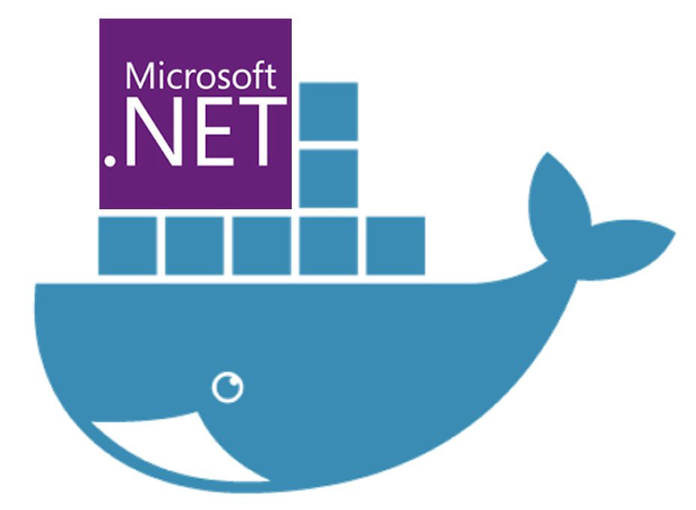
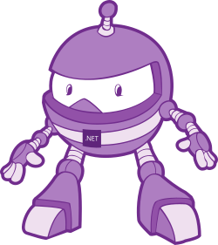

Getting started with Docker
Simplifying software delivery for Developers (even if your boss says you can’t use Docker!)
Slides & code available on Github: https://bit.ly/2EO2lth (case sensitive!)
@dcook_net
Notes:
Today we are going to learn just enough Docker to be useful.
We’ll learn how to get your .Net applications running in Docker, and what that actually means.
We’ll discuss some common use cases that could help your team be more productive.
We’ll see how to get several dockerised applications talking to each other.
And we’ll touch upon how to get your dockerised application into production.
Our examples today will be in .Net Core, but most of what we cover is language agnostic and easily transferable to your language of choice.

Slide 2

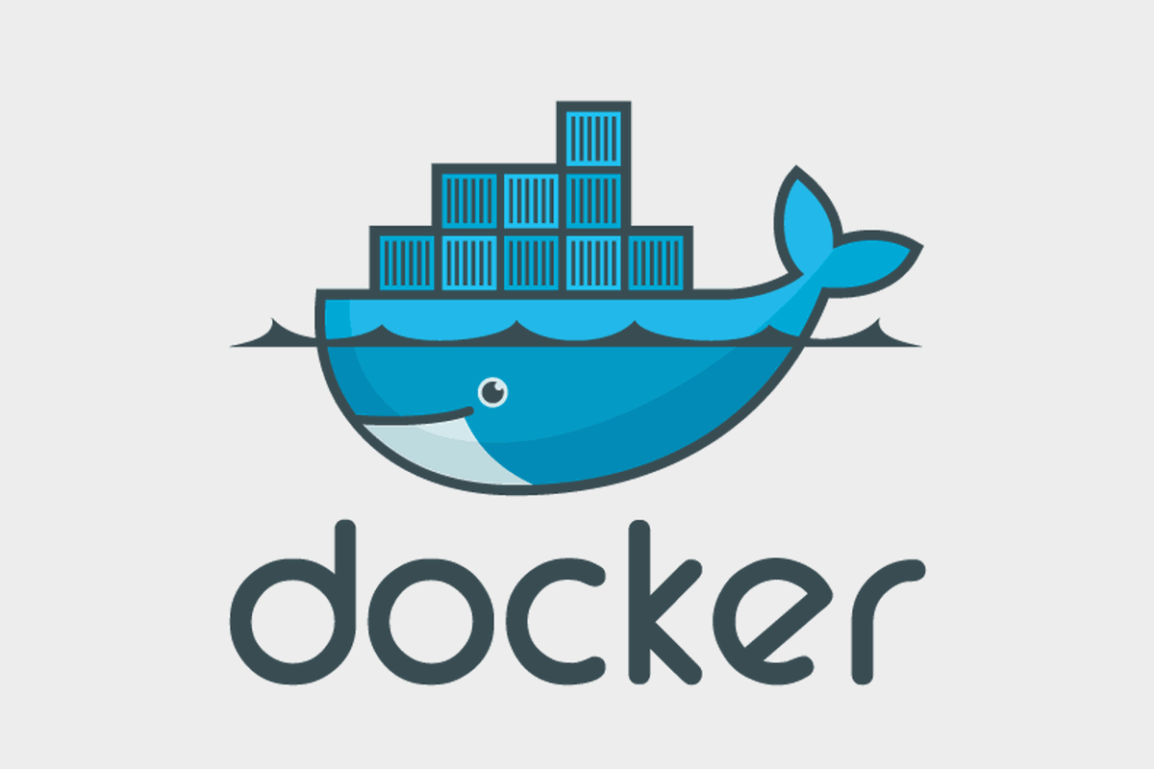
What is Docker?
Notes:
Now a logical way for me to start this talk is to translate the sales pitch on the docker website into simple explanations.
Instead, I’d like you all to think about your first day in a new job, or on a new team, or that open-source project you want to contribute to…
You’re eager to get stuck in…
Your first Job, setting up your Dev environment.

Slide 3
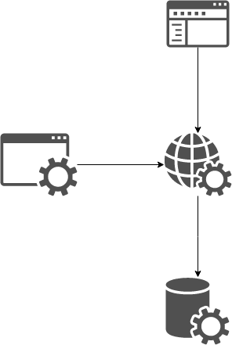
Context: Our Application Stack
Web
Front end
Web
API
Automated
Tests
Database
Notes:
Here is the project you are going to be working on.
A typical 3 tier CRUD application: a database, behind a web service, feeding a front end….and some automated tests to make sure everything is working.
If you are lucky there is a setup document telling you what you’ll need installed, and how to configure it.
If you are REALLY lucky, setup is scripted for you, and the setup document is simply a list of scripts to run and in what order.

Slide 4
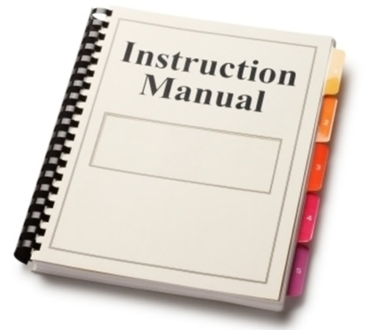

Setting up you Dev Environment
==
Notes:
But how often are these setup documents out of date and missing steps?
How often does something already on the machine conflict with what you are trying to setup?
Wouldn’t it be nice if the setup document was a single instruction, that is guaranteed to work, because the team run it every day?
Docker helps remove all of this pain and achieve just that.
With Docker, I can clone a code repository to my machine and be up and running in minutes.
I don’t need .Net installed.
I don’t need a database installed.
I don’t need IIS or virtual directories (at least, not with .Net Core)
I just need Docker and the source code.

Slide 5
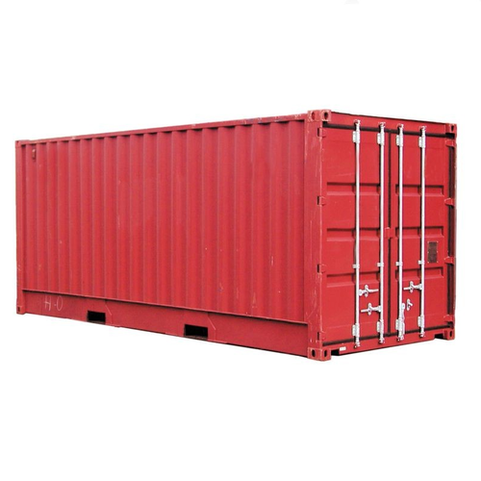

Same Stack, but running in containers
Notes:
Time for our first demo.
Having just pulled our source code from github,
I will run a single command and launch our entire application within Docker Containers.

Slide 6
Demo 1
Notes:
./run.sh

Slide 7
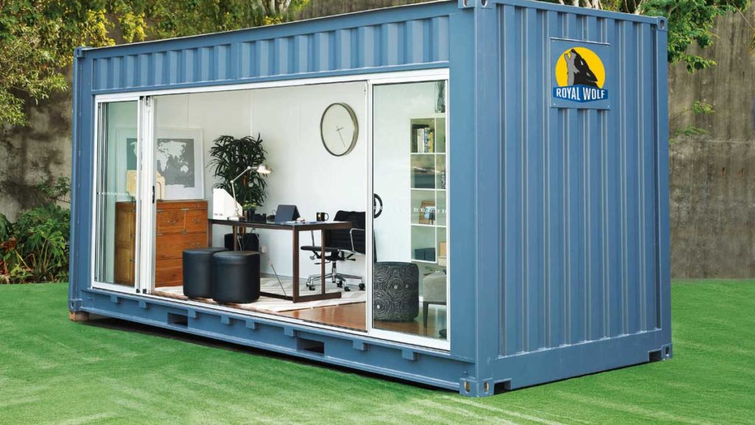
Use cases for Docker
Notes:
Now that you have seen Docker in action, you probably have a few ideas about how you can use it within your teams.
Here are a few ways that I’ve seen it used in order to make teams more productive.

Slide 8

QA / Testers
Notes:
Testers/QA.
Typically they maintain suites of automated tests that ensure a system is working to spec.
And these tests will usually run in some sort of CI pipeline somewhere.
But they are created and maintained on QA’s local dev environment.
With Docker, they no longer need to worry about maintaining a working Development environment.
They can simply launch the whole system with Docker, and start writing and running tests against that stack.
They can focus on what is important to them, without the worry of keeping the environment up-to-date with new versions.

Slide 9

UI Devs
Notes:
UI Devs.
Their focus is on CSS and Markup.
They shouldn’t need to worry about what version of .Net is installed, or what version of the Database they have.
Docker allows them to focus on what is important to them, by simplifying the build and run process.

Slide 10

Devs
Notes:
Devs/Engineers:
When implementing changes to part of a system, we no longer need to host all of our downstream dependencies within your IDE.
Instead, you can launch these dependencies in the background in Docker.
This helps to reduce the feedback loop by reducing what you need to keep recompiling and testing locally.
This is really useful in polyglot, or microservice teams.

Slide 11
Context Switching
Application Y:
MVC
Web API
SQL Server
Application X:
React
Node.js
Mongo
Notes:
I’ve been using Docker for about 3 years now, and I’ve made a few observations along there way.
I think that Docker helps lower the barrier to entry for new or unfamiliar Tech.
For example, before I learnt any Node, I was able to launch a Node service within Docker, point my app at it and start consuming it’s endpoints without needing to learn anything about Node, or NPM.
I was productive much faster than I would have been without Docker.
I’ve also found that Docker reduces the overhead of moving from one project to another, which I often do on my team as we run ~18 microservices in both .Net and Node.
It is really useful being about to move from service to service, using the same commands to launch the various solutions, regardless of tech used.

Slide 12

You can’t use Docker! (In Prod)
Notes:
All of these advantages, and we’re not even close about talking about Production yet.
So, if you’ve ever been told you can’t use Docker (meaning Production),
It doesn’t mean you and your team can’t benefit from using it elsewhere!

Slide 13
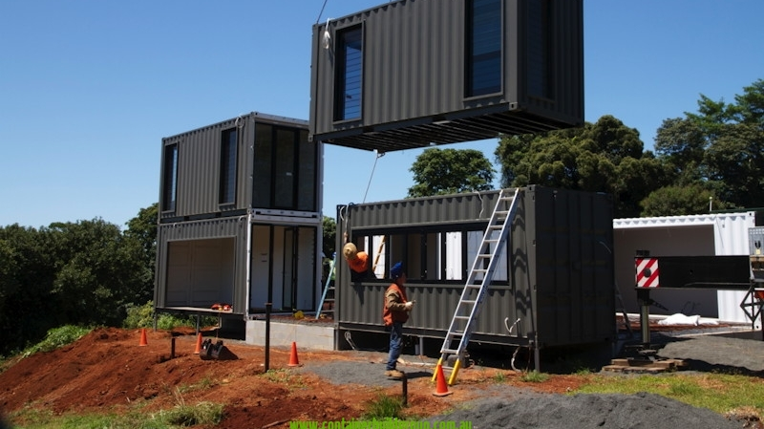
Building Containers
Containers are running instances of Images
Images are created from a Dockerfile
Dockerfiles contain instructions of how to build you application
Notes:
In the demo, we launched multiple dockerised applications at once.
But in order to explain that, first we need to know how to get a single app into Docker.
When we Dockerise an application, what we really mean is that we are running it within a Container.
Containers package up our software, and all of it’s dependencies, into a single, portable artefact.
So that means things like our Dlls and configuration, but it also means the version of the .Net runtime that it requires to run, and even the operating system that the runtime needs.
Containers ship with EVERYTHING then need to run, so that when you start one up it has everything it needs.
And Containers will run anywhere that Docker is installed, even if .Net is not installed too.

Slide 14
Building Containers
Dockerfile -> Image -> Container(s)
Notes:
So how do we get our apps inside a Container?
First you need an Image. Containers are actually running instances of an Image.
Images are like blue-prints and define everything your Container needs to run.
You build an Image from a Dockerfile, which contains all the instructions needed to create your Image.

Slide 15
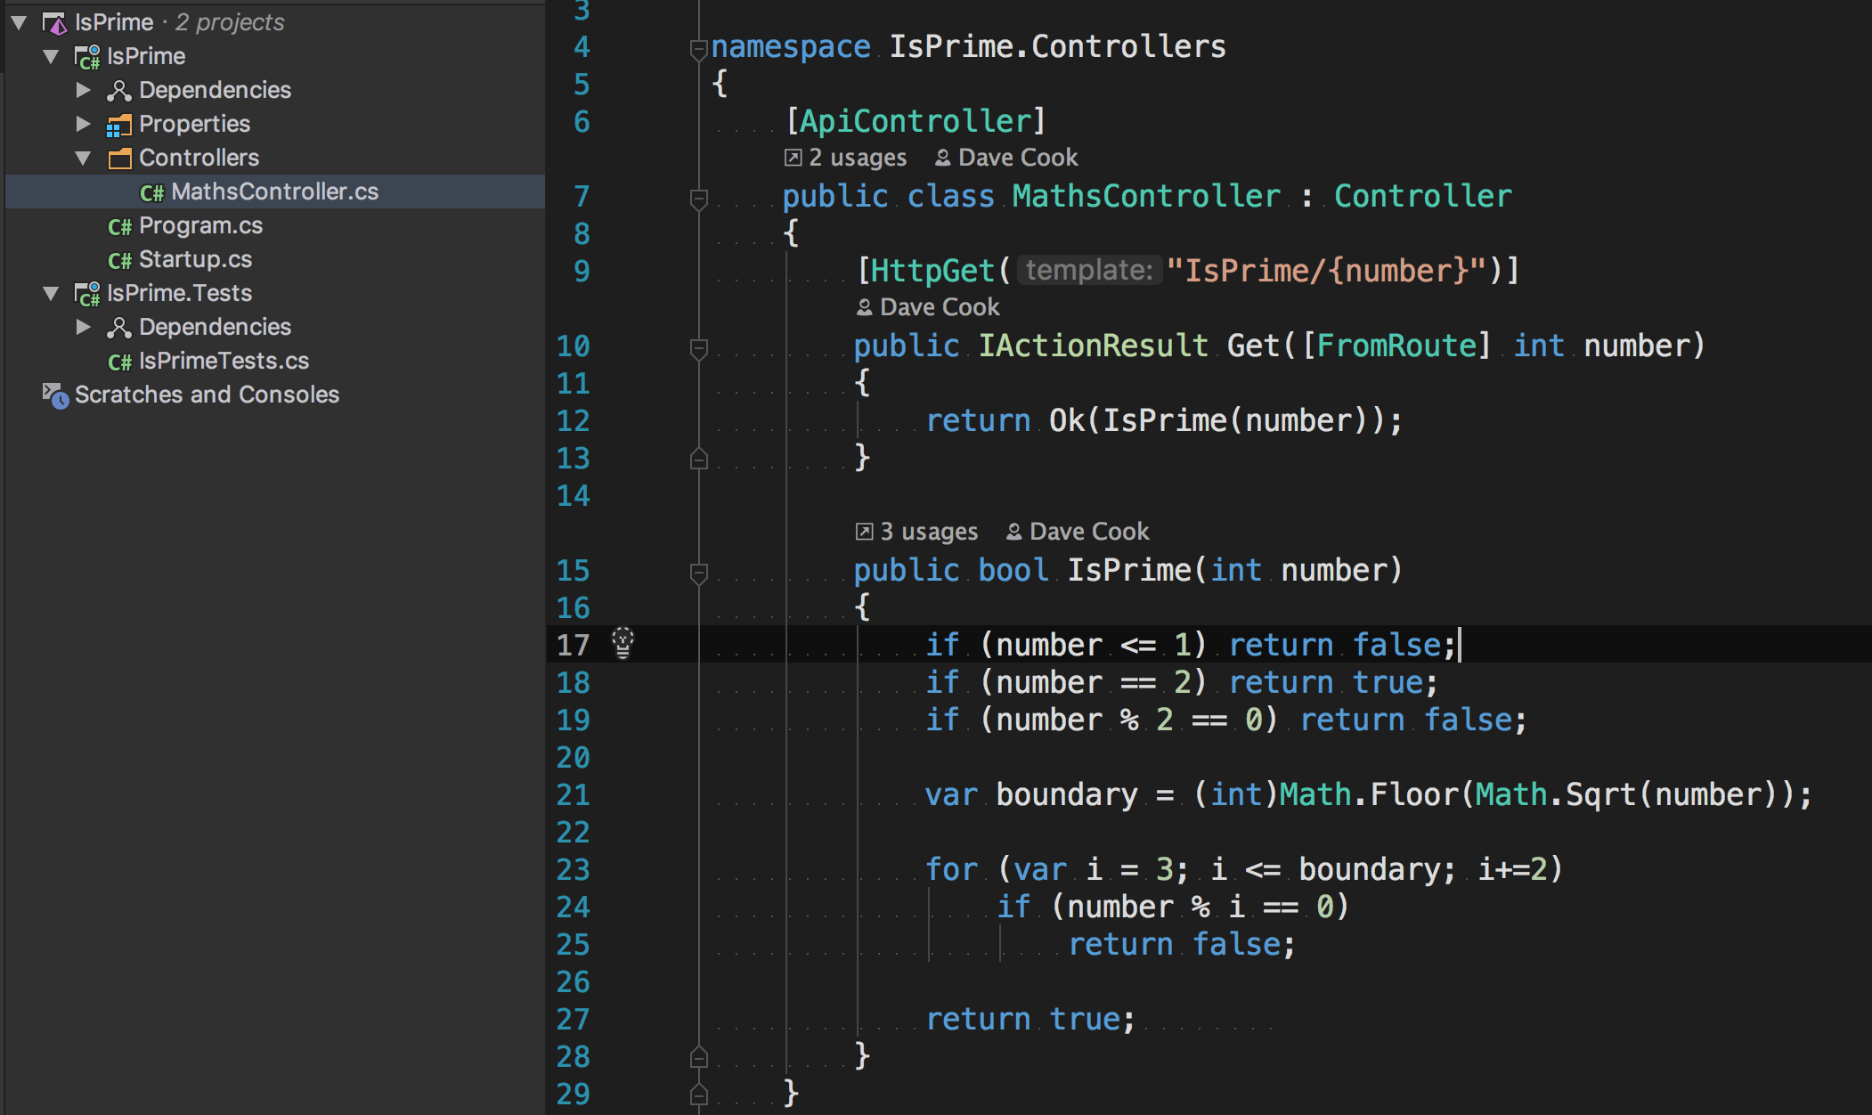
Context: Our Sample service
Notes:
We’ll see our first Dockerfile in a moment, but before that, we need a little context on the application we are going to Dockerise.
It’s a simple Web Api Server, with a single HTTP Get endpoint, which evaluates if the number on the URL is a Prime Number or not.
On the Left you can see our solution consists of two projects, 1 for our Api and one for the tests.
On the right you can see the source code.
Super simple stuff: I’ve omitted things like error handling and validation for clarity.
The service runs on port 9021, which will become relevant shortly.

Slide 16
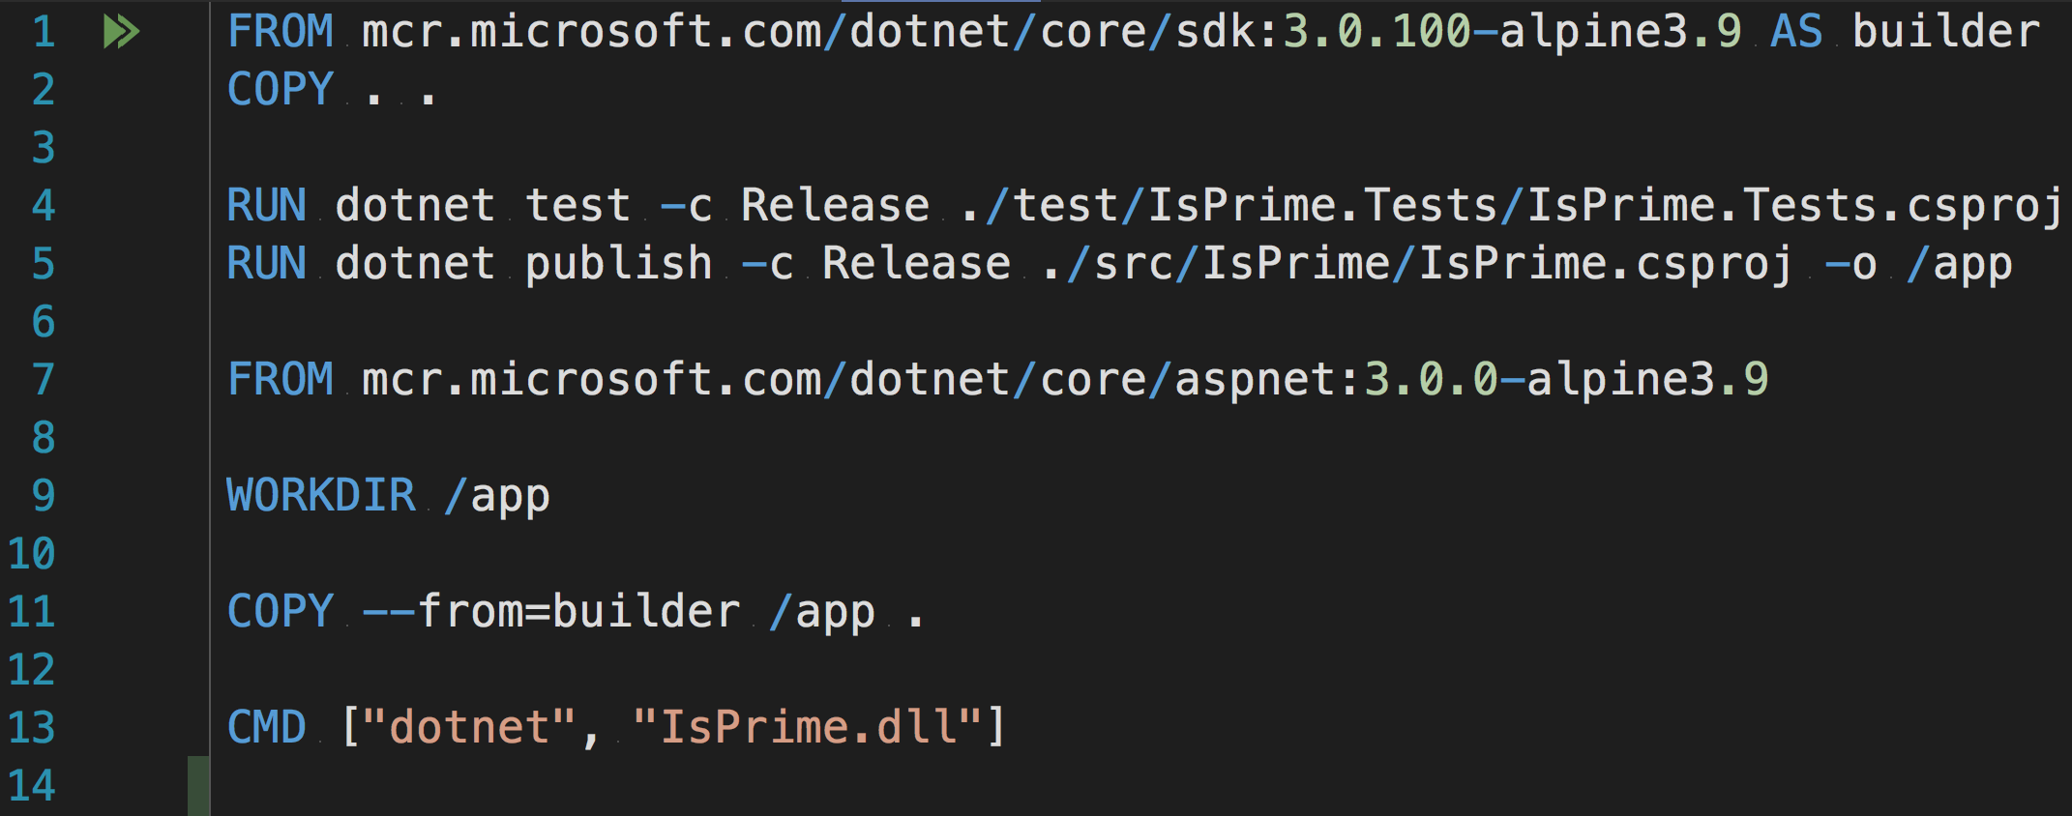
Our Dockerfile
Notes:
Here is the Dockerfile we will use to create an image of our application

Slide 17
Our Dockerfile
Notes:
It contains 8 instructions

Slide 18
Dockerfile
Notes:
This is actually what is known as a Multi Stage dockerfile, because it contains multiple FROM instructions.
Each FROM instruction will create a new image, and the image created by the final FROM instruction will then be used to spin up container instances
Lets walk through what each of these instructions is actually doing

Slide 19
Dockerfile
Notes:
First we create an image based on the Dotnet Core SKD

Slide 20
Dockerfile
Notes:
We then copy our source code from the host file system, to the file system on that new image

Slide 21
Dockerfile
Notes:
The, using the Dotnet CLI already installed on the image, we perform a Dotnet test against our app to make sure it is behaving as expected,
And then perform a dotnet publish in Release mode, if those tests pass.

Slide 22
Dockerfile
Notes:
At this point, stage 2 of the docker build begins, as execute our second FROM instruction.
This time we base the new image on the Dotnet Core ASP NET runtime image

Slide 23
Dockerfile
Notes:
We then copy the output of our publish step in stage 1, to the file system of the image created in stage 2

Slide 24
Dockerfile
Notes:
And finally, we tell Docker to run the dll we created during that publish command whenever any container instances based on this image launch

Slide 25
Dockerfile: No Changes to our code!

Slide 26
Dockerfile
Notes:
There are a few things to point out about this process:
First of all, we’ve not changed our code in order to make the application run in Docker.
It is exactly the same code that we would run in IIS or Visual Studio.
The only difference is the presence of the Dockerfile
Secondly, none of our source code ever reaches the final image that we’ll use to create container instances.
The source code was copied to stage 1 and used to compile, test and publish the application, but only the published DLL ever get’s copied to the final stage

Slide 27
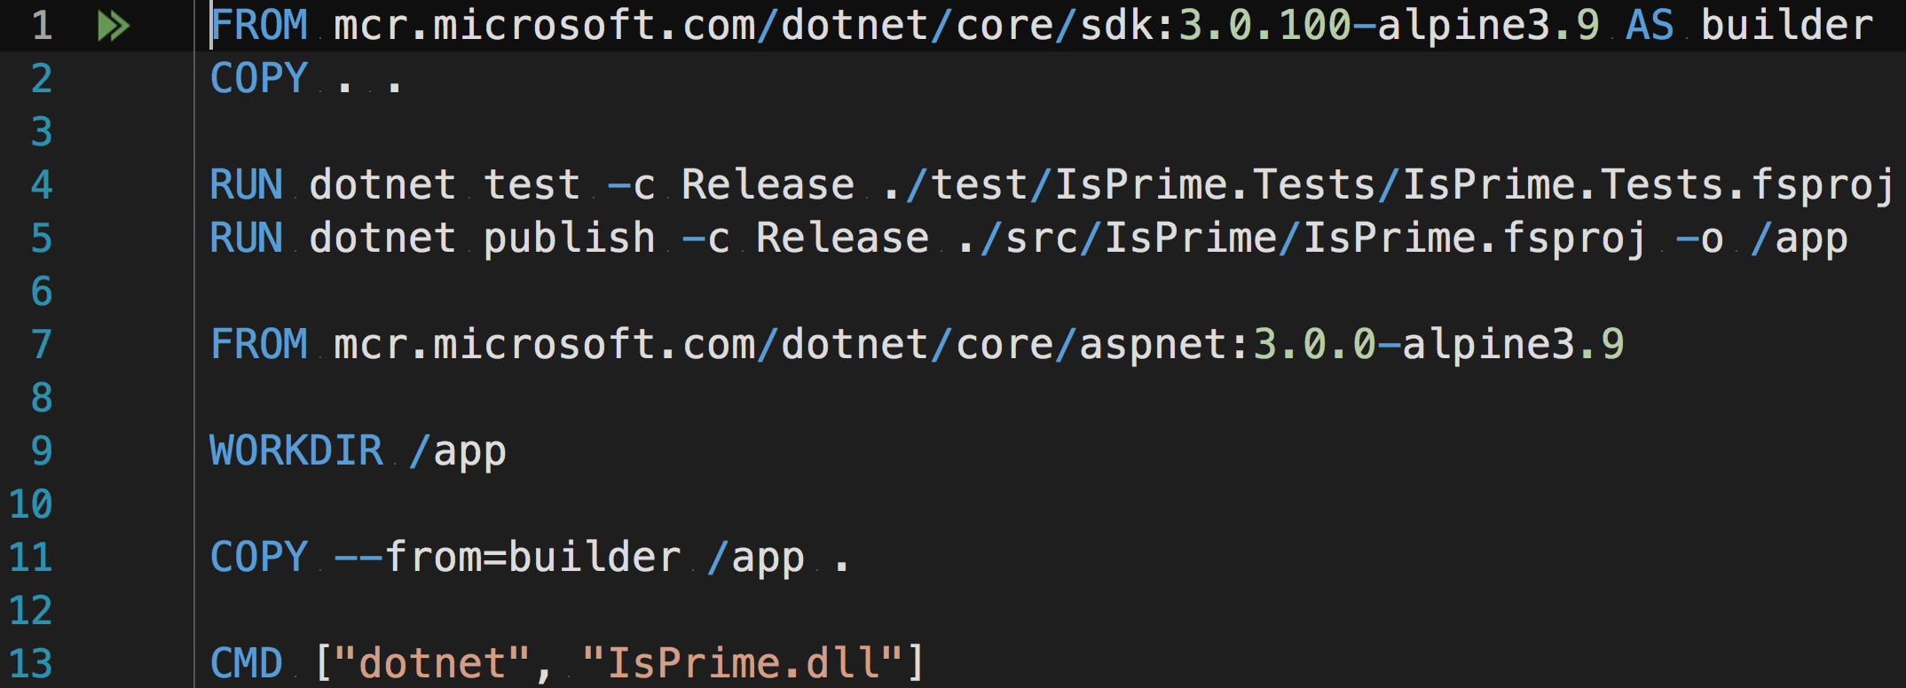
Dockerfile – F#
Notes:
Fun Fact for anyone interested in F#
If we’d created our app in F#, then the only difference to the Dockerfile would be the file extensions of the project files
Everything else would be exactly the same.

Slide 28
Dockerfile
Notes:
The images we are using here are built and maintained by Microsoft, and pushed on their public Docker repository known as the MRC or Microsoft Container Registry.

Slide 29
Dockerfile
Notes:
The reason I’m pulling images from the MRC instead of the default repository on DockerHub is because I want the very latest partch release version of the image, as that contains the latest security vulnerability hot fixes, and Microsoft no longer publish these images to DockerHub, only the MCR.
I’ve included a link on the resources slide towards the end of the slide deck that explains why Microsoft work like this.

Slide 30
Dockerfile
Notes:
The full name of the images we are using consist of a name, and some tags, separated by a semi colon.
I would recommend always, always specifying tags whenever you pull an image from a docker repository.
This is because, if you don’t, docker defaults to using a Tag called latest.
And unfortunately, Latest does not actually behave in the way you might expect something called latest to behave.
So, in order to achieve 100% deterministic builds, Always specify the specific tags of the image you want.

Slide 31
Dockerfile
Notes:
The tags that I’m using here specify the latest version of the Alpine variant of the Linux OS.
This is because Alpine is a really light weight version of Linux, and I’m trying to keep my images as small as possible.
Smaller images will upload and download faster to your Docker repository, so the smaller your images, the faster your build and deploy processes will be.

Slide 32
Dockerfile
Notes:
Whether you are using .Net Core or the .Net Framework, and whether you are running on Docker or not, you should always be running your production environment on the runtime instead of the SDK.
There are a few reasons for this.
Firstly, the SDK provides much more functionality than the runtime, and as a result, exposes a larger attack vector for hackers to exploit should they get on to your live kit.
Secondly, due to that extra functionality, the size of the SDK images is also much larger than the runtime images, and as we already know, smaller is better when it comes to Docker.

Slide 33

Dockerfile
Notes:
And finally,
This build is completely ATOMIC.
If the application fails to compile, a test does not pass, or any part of this process fails, we don’t get our image generated.
Instead we exit the build with an error code

Slide 34
Build an Image
docker build -t isprime_dotnetcore:1 .
Notes:
Now we have a Dockerfile, we need to use that to create an Image.
We do that with the Docker build command.
We are passing it 2 args:
The 1st, -t, is the name and tag combination that we will use to referrer to this Image once it’s created.
The 2nd, a full stop, is what’s know as the build context, and is actually reference to the current directory.
It says to the Dockerfile, execute all your commands within the context of this path.
As we have not actually specified a Dockerfile to use, Docker is defaulting to look for a file called ‘Dockerfile’ in the current directory.

Slide 35
Demo – Build an Image
Notes:
docker build -t isprime_dotnetcore:1 .

Slide 36
Start a Container
docker run -p 80:9021 isprime_dotnetcore:1
Notes:
Now we have an image we can spin up a container instance to host our app.
We do that with the Docker run command.
Again, we are passing 2 args.
The 1st –p, maps port 80 on our Host machine to port 9021 on the image, which is where our application is actually running.
The 2nd, is the name and tag combination of the image that we want an instance of, which is the same as the Image we just created.

Slide 37
Demo – Start a Container
Notes:
docker run -p 80:9021 isprime_dotnetcore:1

Slide 38
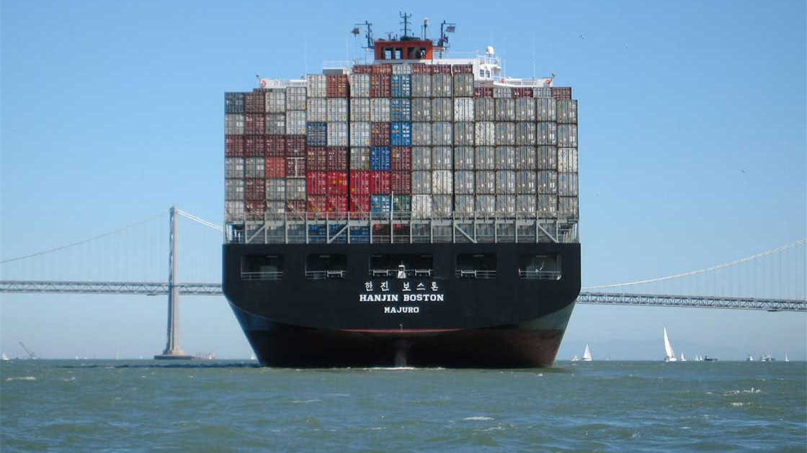
Docker Compose
Notes:
So now that we know how to build an Image containing our application, and launch an instance of a Container, it’s time to go back to where we started with our First Demo.
We used a tool called Docker-Compose to build and launch multiple Containers with a single command.
It does this by allowing us to define multi Container applications in a YML file.

Slide 39
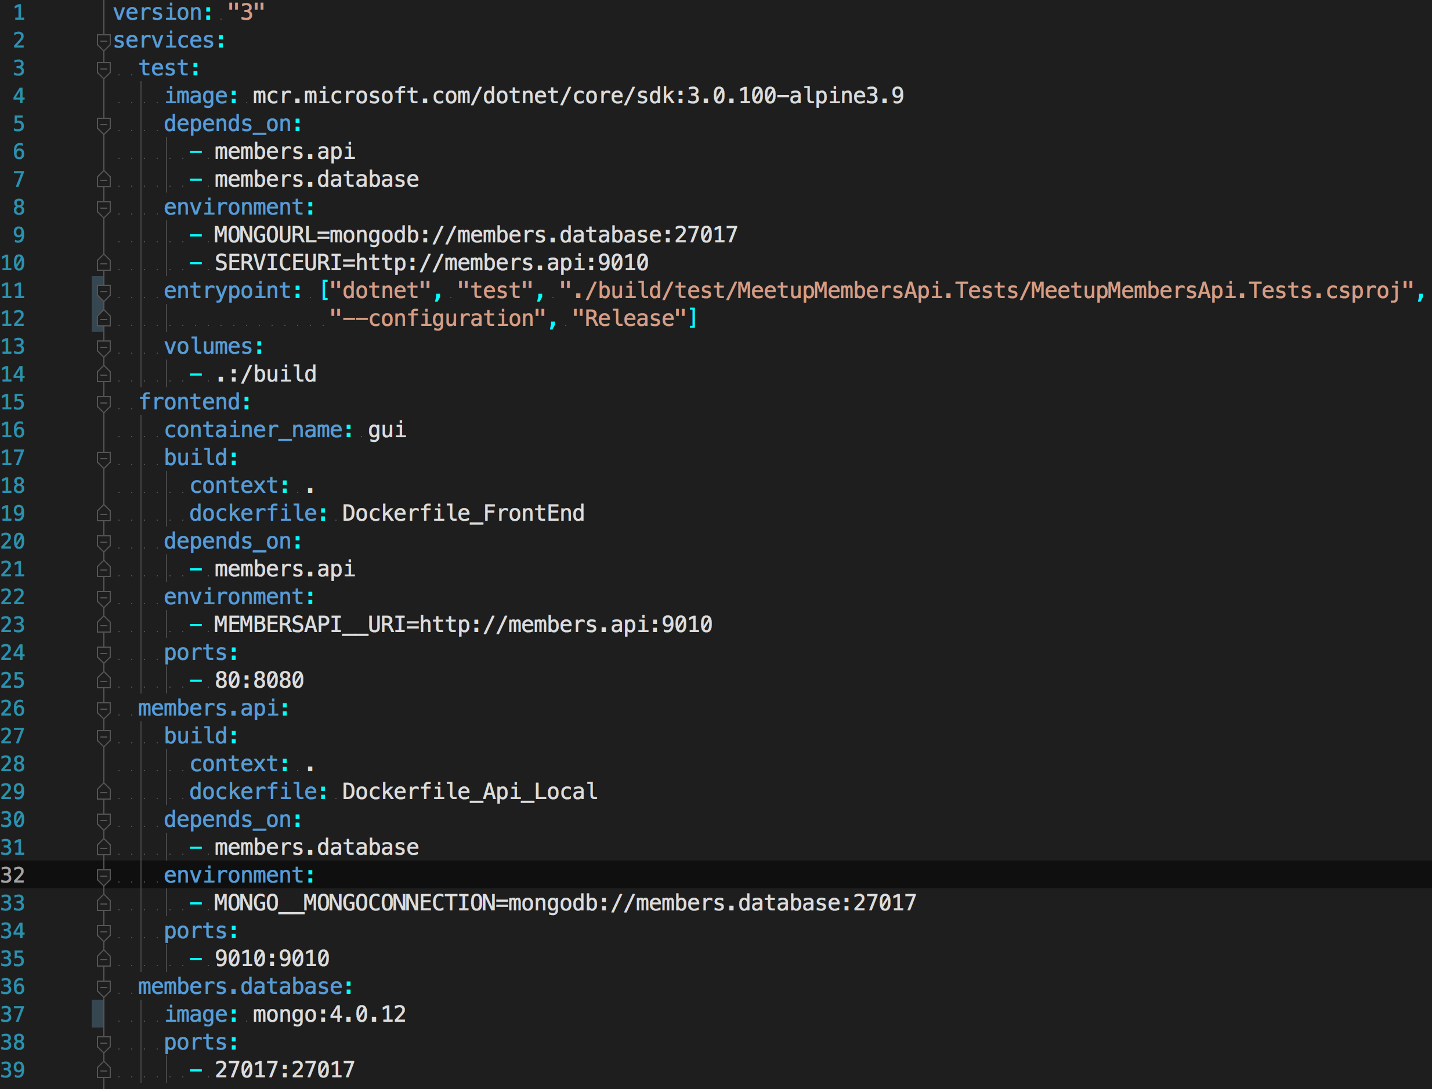
Docker Compose YML
Notes:
Lets have a look at the compose file we used in that demo

Slide 40
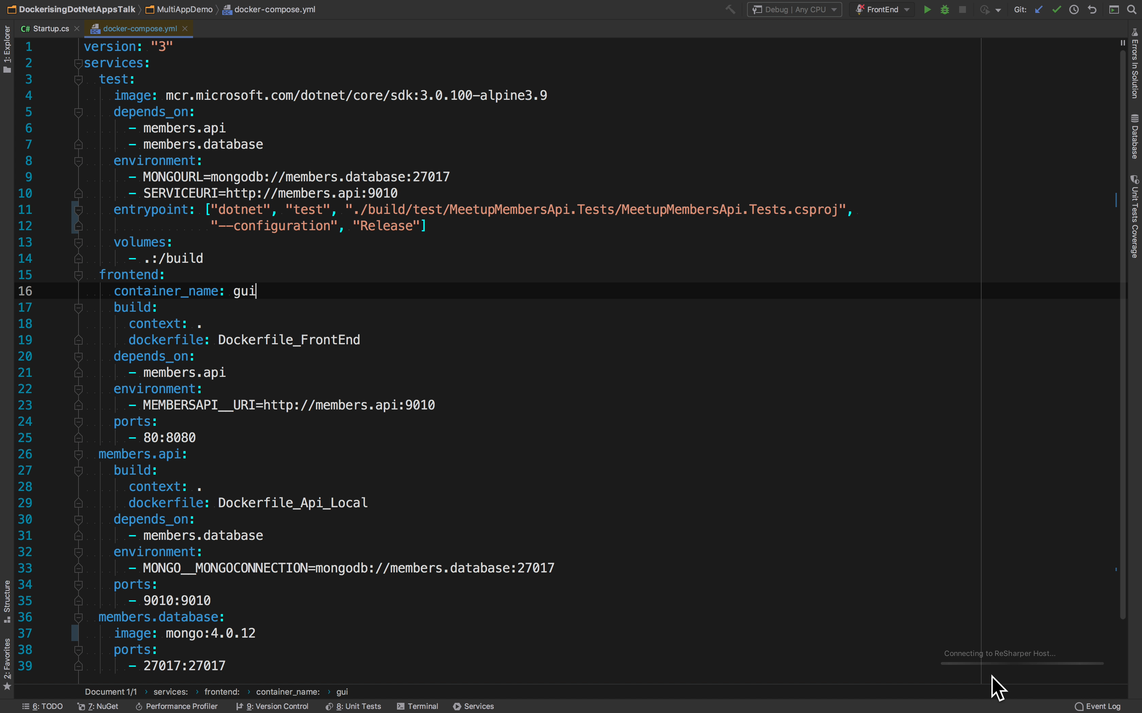
Docker Compose YML
Notes:
If you remember, we had 4 containers: 1 for each the two web sites, one for hosting our database, and another for our automate tests.
You can see each of those services defined here in our compose file under ‘Services’

Slide 41
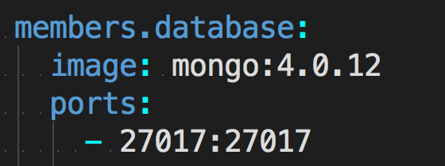
Docker Compose YML
Notes:
Starting from the bottom up:
First we have our database: this uses a Mongo Image from DockerHub to create a container instance hosting our Database and exposes the default port

Slide 42
Docker Compose YML
Notes:
Its important to note that I have no Dockerfile defined for Mongo..
We are using an existing image, built by the Mongo Devs and published on Dockerhub
We are simply pulling this image and using it to spin up an instance of a Mongo Container

Slide 43
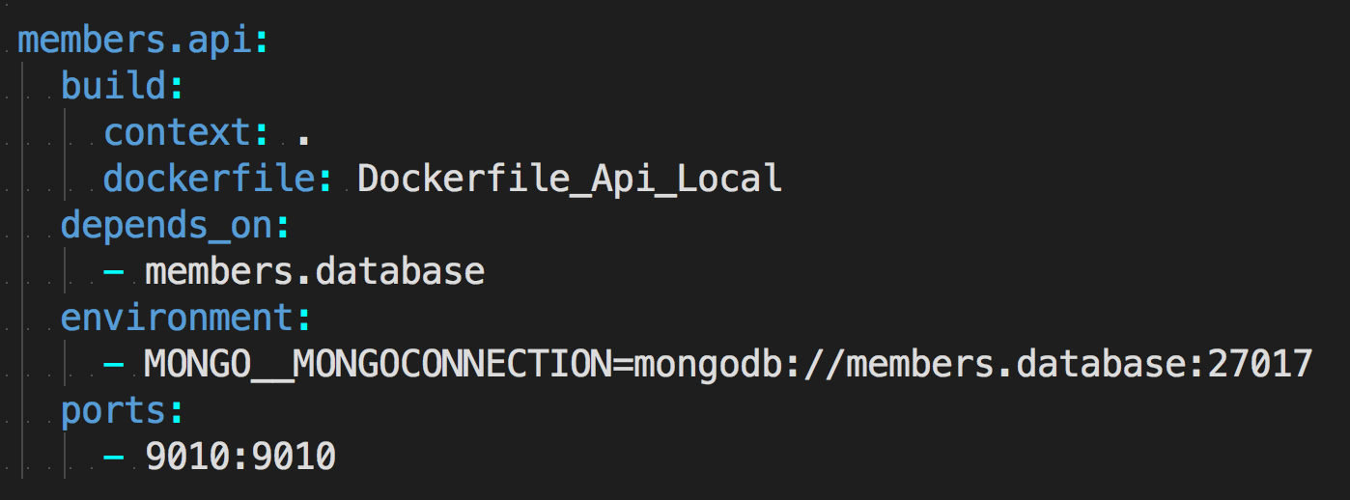
Docker Compose YML
Notes:
Next we have the web api service, which is different to the mongo sevice, in that it depends on a Dockerfile to build an image, rather than use an existing one.

Slide 44
Docker Compose YML
Notes:
The syntax here says: ‘From my current location use a Dockerfile named Dockerfile_Api_Local, and that contains all the instructions needed to build an image and launch a container’

Slide 45
Docker Compose YML
Notes:
A few important points to note:
Depends_On: This tells Compose that this service requires the Mongo Service in order to run.
Compose will launch any service that another service depends on first, so that everything always has what it needs in order to run.

Slide 46
Docker Compose YML
Notes:
Environment Variables:
The environment arguments here are passed to the container when it is spun up
In this example, we set the DB connection string for connecting to Mongo, which is configurable in our application

Slide 47
Docker Compose YML
Notes:
Now, if you inspect the actual value of the connection string, you’ll see that the we are actualyl using the name of the Mongo Service that we’ve just seen
Remember earlier I said that Docker creates its own little network and adds each container to that Network…
When it does this, each container is reachable by the others, and discoverable via the container name.
So it is possible to refer to another service via its name in YML, and Compose will resolve that as an IP on it’s network at run time.
So the Mongo DB connection string here will actually resolve to the IP address of container hosing our mongo Instance.
WE are getting dynamic DNS lookups on our Docker Network….Now that is pretty cool!

Slide 48
Docker Compose YML
Notes:
Finally, we map our ports from the host to our container as we’ve seen before

Slide 49
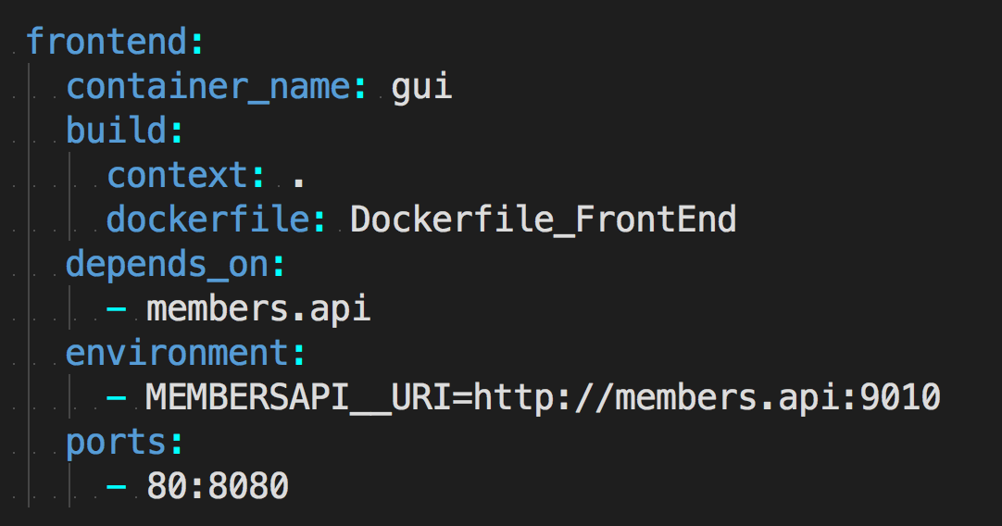
Docker Compose YML
Notes:
Moving on to the Frontend Service

Slide 50
Docker Compose YML
Notes:
Like our api, this service uses a Dockerfile in order to build an image and start a container

Slide 51
Docker Compose YML
Notes:
It depends on the backend API

Slide 52
Docker Compose YML
Notes:
And we configure an environment variable to tell the front end how to talk to the back end.

Slide 53
Docker Compose YML
Notes:
Note that the Uri and port match the service name and port of the back end service

Slide 54
Docker Compose YML
Notes:
Then we map our ports again
This time we have mapped port 80 on the host to port 8080 on the container, allowing us to browse to the site using just localhost in the browser

Slide 55
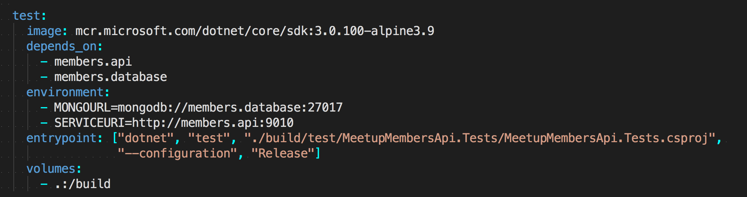
Docker Compose YML
Notes:
Finally, we our tests that run against our API layer..

Slide 56
Docker Compose YML
Notes:
Like our mongo service, we are using an existing image, rather than a Dockerfile

Slide 57
Docker Compose YML
Notes:
It depends on BOTH the members api and the database services

Slide 58
Docker Compose YML
Notes:
And we’ve configured environment variables to allow the tests to connect to both of those services.

Slide 59
Docker Compose YML
Notes:
The entry point instruction tells Docker what to run when this container starts: in this case a DOTNET test command

Slide 60
Docker Compose YML
Notes:
And then finally, we have a volume, which allows us to share data between our host file system and our container file system.
This instruction binds the container build context to the host file system, allowing the container to access the source code of our tests and run the dotnet test command against the files located in the volume.

Slide 61
Docker Compose YML
docker-compose up
Notes:
And that’s it. That’s all there is to it for this simple stack.
Obviously a more complicated scenario would require a bit more work;
For example;
- sensitive environment variable such as passwords
Or logging into a private docker repository with credentials
These will require a few extra hoops to jump through, but they are all do able
Let’s quick launch all this again using docker-compose up

Slide 62
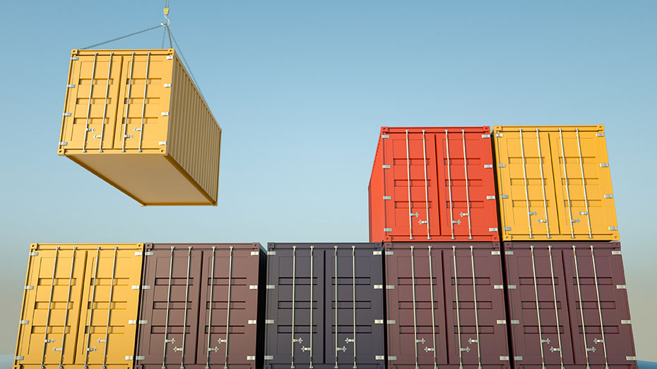
Road To Production
Notes:
So you now know how to use Docker locally, but what about Production?

Slide 63
Automate your build process
Images created locally are throw away artefacts
Automate the build & publish of Images
Build agents/ CI servers don’t need .Net installed
Can deploy to anywhere that Docker is installed
Notes:
While you will perform all the tasks we’ve seen here today locally, in reality you will be using some sort of CI process to automate your Build process.
Something like Jenkins or Azure Pipelines will actually build your images for you and publish them to your Docker Repository.
Once in Docker, deploying to a new environment is as simple as downloading the Image and performing a Docker run.
Again, you’ll likely automate this.
Your target environments and build agents do not need .Net installed, as the Images contains everything they need to run.
As long as Docker is installed, deploying to a new environment is easy

Slide 64
What this means for Devs
No longer depended on Sys Admins
Complete control over the software we use
Deployments are fast & repeatable
Docker supported by all major cloud providers
Notes:
What this means for use Devs is:
We are no longer dependent on sys Admins to configure test and Production servers in readiness for our apps
We have complete control over the versions of software that we use:
No more being stuck on version X of Y because team A uses the same kit – each container is completely isolated from the next.
Deployments are fast and repeatable, and we can react quickly to spikes in traffic by spinning up new instances to deal with the load.
We can also avoid vendor lock in, as Docker is supported by all the major cloud providers.
You can even run it on prem

Slide 65
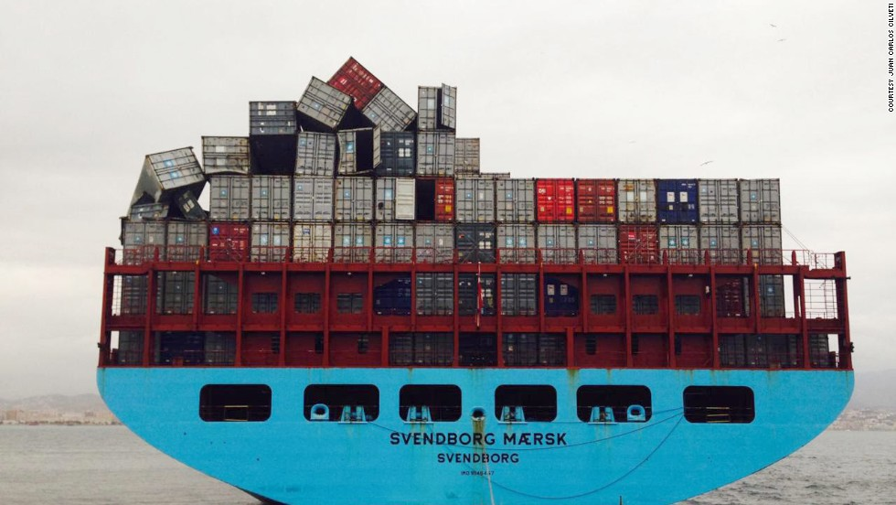
New Challenges
Notes:
However, choosing to adopt Docker will also bring some new challenges to overcome.
Here are a few things you’ll need to consider

Slide 66
Things to consider
Learning curve
Managing Containers is not Free
How do you access your logs?
Can I log on to live servers?
Notes:
There is a learning curve, especially if you are historically a Windows person with little experience of Linux systems.
Managing containers goes not come for Free, you’ll need to figure out how you monitor instances, stop old instances when deploying, manage load balancers, restart stopped containers.
Basically, you’ll need to relearn how to run your software in the wild.
You’ll need to figure out how to access your application logs in order to diagnose any issue in production, which is going to be tricky if you can’t even log on to your Live servers.
The good news is though, that you can practice and experiment on internal environment and processes to find what works you.
Make mistakes and answer these sort of questions before you even start thinking about Production.
You don’t need to go ‘All In’ on day one.

Slide 67
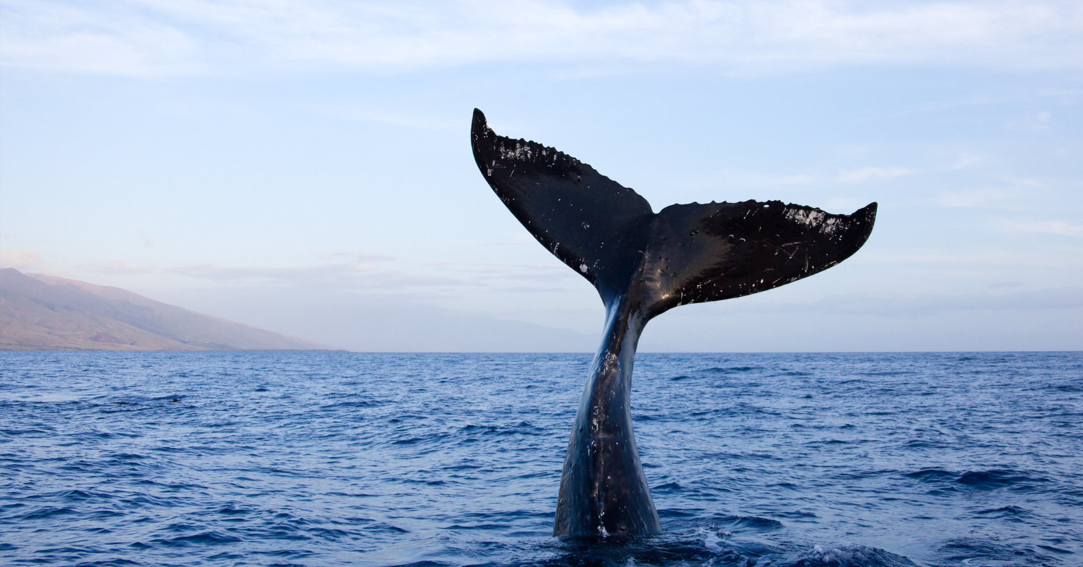
Fin!
Notes:
That’s it.
You should have everything you need to go and start playing with .Net applications in Docker.
There are other ways to do things that’ve I’ve not had time to cover, and there are things such as security that I’ve not touched on,
But you should have everything you need to get started and avoid some pitfalls.

Slide 68

Quick Plug, then Questions
www.dddeastanglia.com
Notes:
Before we go to questions, time for a quick plug.
Registration for DDD East Anglia opens on Friday the 19th.
Remember its free to attend, and the Agenda is now available, so please go take a look.

Slide 69
Resources
Exploring Net Core Docker Files - Andrew Lock
Docker for .Net Developers (7 part Series) - Steve Gordon
Announcing the Microsoft Container Registry - Rich Lander
How To Build a Smaller Docker Image – Medium
What's wrong with Latest and The misunderstood latest tag
Play with Docker Classroom - Dockers Labs
https://docs.docker.com/engine/examples/dotnetcore/

Slide 70


Questions?
https://medium.com/@dcook_net
@dcook_net
https://github.com/dcook-net/
Slides & code : https://bit.ly/2EO2lth

